Slide 1
HBV Input Uncertainty: Assignment 4
Impact of precipitation uncertainty and recalibration
Group A: Adrien, Nafisa, Vincent
MMUQ – Assignment 4 summary
Notes:
[Sources]
- User-provided plots and exported slides from prior assignment (local files).
[/Sources]

Slide 2
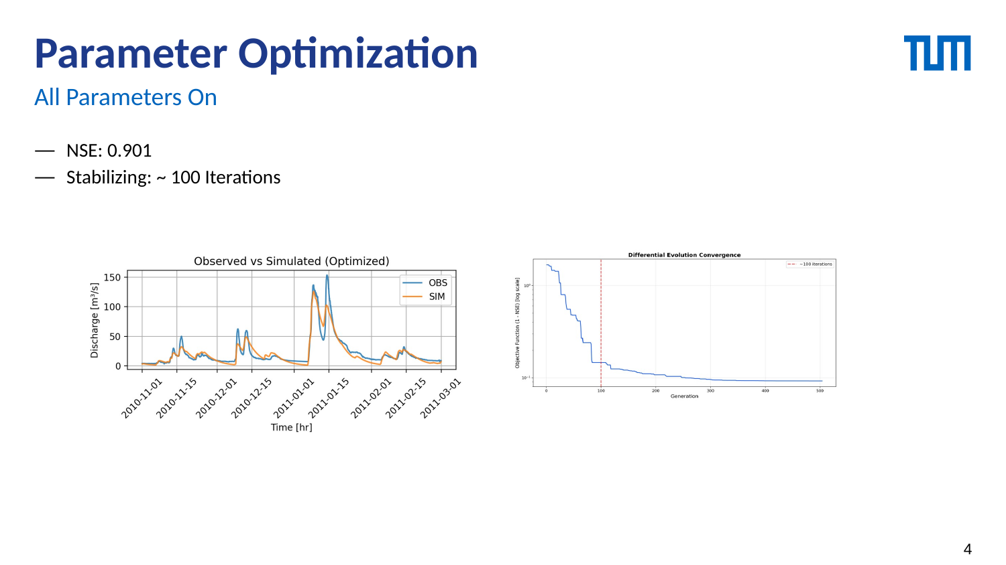
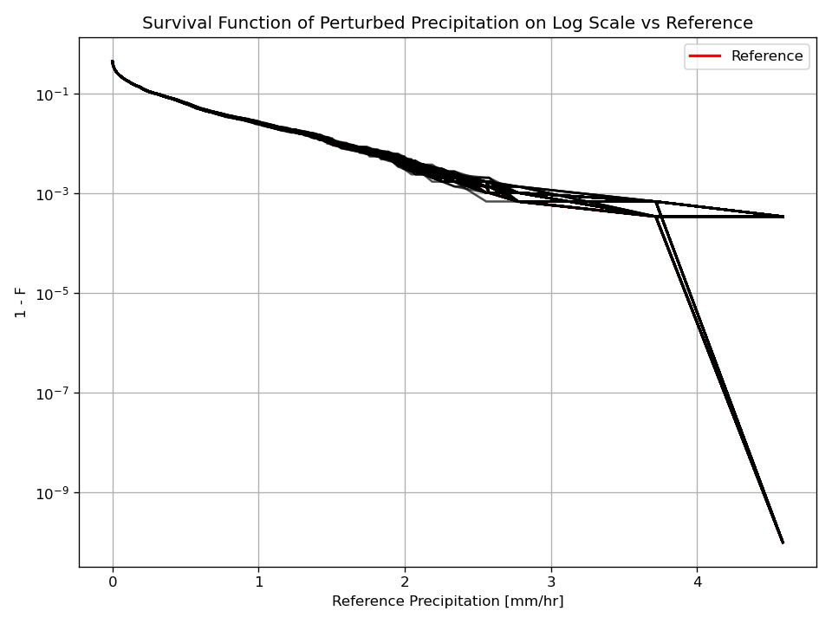
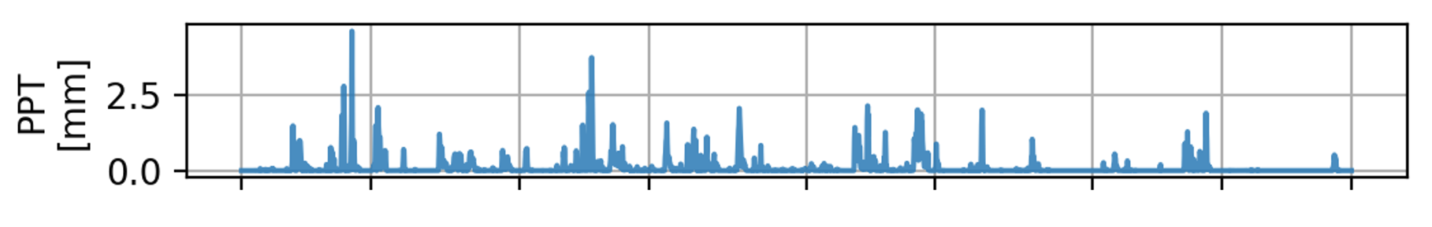
What is being compared?
Fixed input calibration (A1) vs precipitation-uncertainty experiment (A4)
Recall: Assignment 1
Assignment 4 (Uncertainty)
Calibrate HBV on reference forcing using DE
Produce “best” parameter set (BEST_PARAMS)
Report baseline NSE / OFV and hydrograph fit
• Perturb precipitation: P* = P × C
• C ~ N(1, 0.05)
• Scenario A:
Perturbed precipitation series + parameters from assignment 1
• Scenario B:
Perturbed precipitation series + parameters from recalibration
• Compare OFV/NSE + parameter distributions
2
Notes:
[Sources]
- Baseline figure: extracted from user-provided Assignment_3_Improved.pptx (slide 5).
- A4 precipitation CDF: user-generated plot (1_cdf_precipitation.png).
[/Sources]

Slide 3
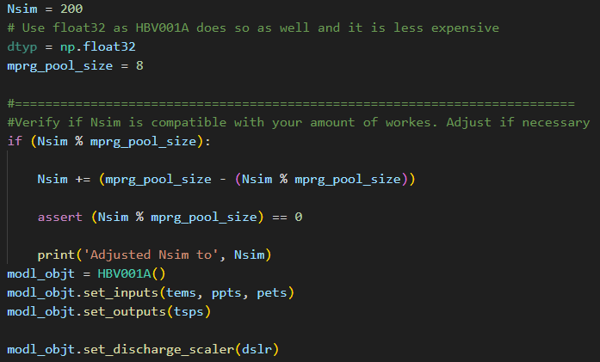
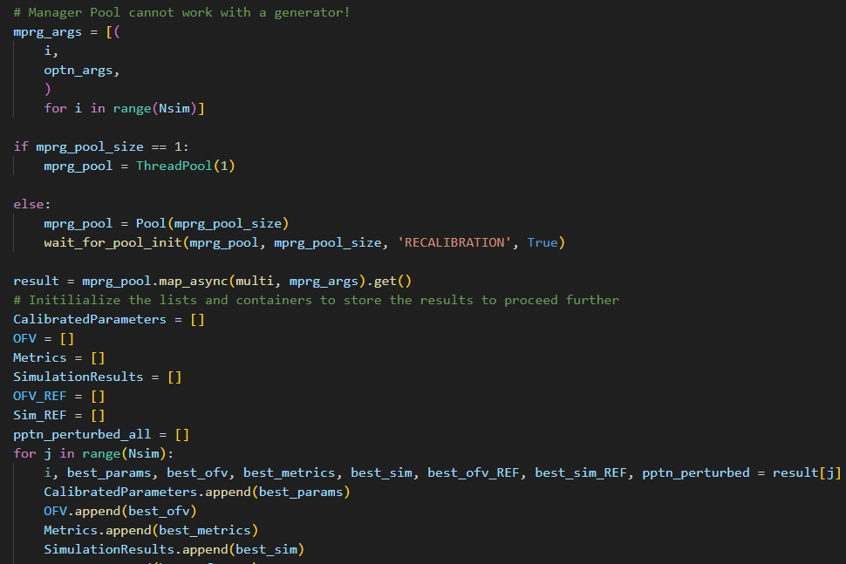
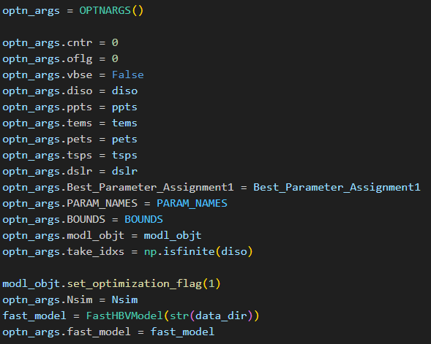
Implementation - Multiprocessing
Setting up multiprocessing
3
Notes:
[Sources]
- Boxplots: user-generated (6_boxplot_*.png).
[/Sources]

Slide 4
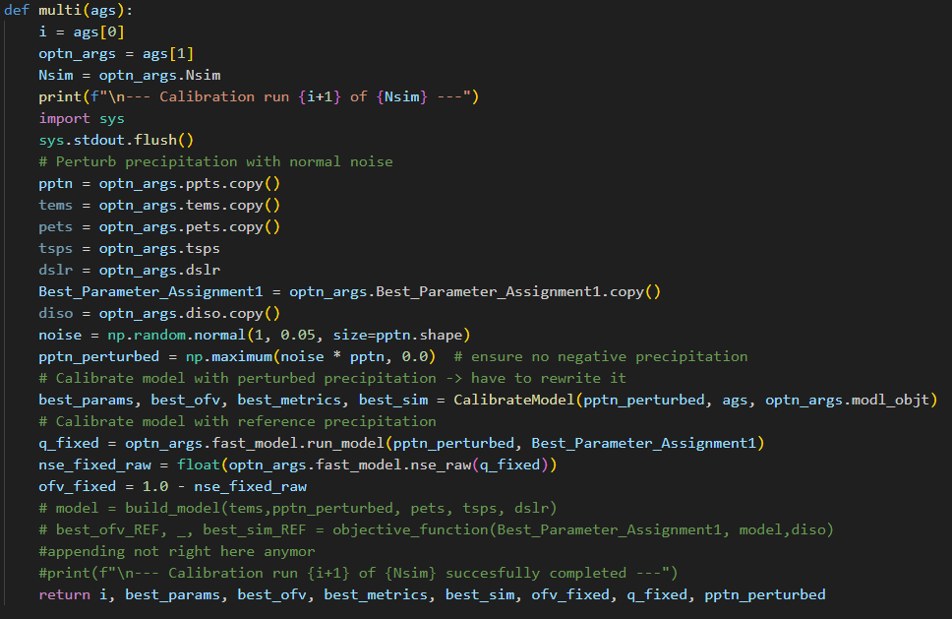
Implementation – Multiprocessing and Principal Function
Implementing the assignment
4
Notes:
[Sources]
- Boxplots: user-generated (6_boxplot_*.png).
[/Sources]

Slide 5
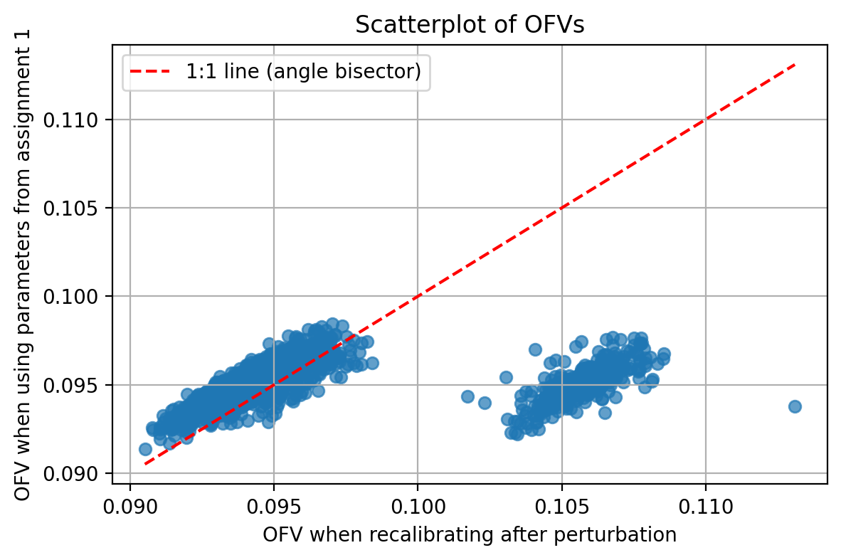
Assignment 4 – Quick Overview
1) Perturb precipitation
2) Scenario A: fixed params
3) Scenario B: recalibrate
C ~ N(1, σ)
C = max(C, 0.05) to avoid negative/zero
P* = P × C
Run HBV with P* and BEST_PARAMS
Compute NSE_fixed, OFV_fixed
Optimize params for P*
(L-BFGS-B, bounded)
Compute NSE_recal, OFV_recal
If OFV_recal < OFV_fixed (points above the 1:1 line in the scatter), recalibration “compensates” for input uncertainty.
If many parameters stay constant, the model is less sensitive (or the optimizer converges to the same local optimum).
5
Notes:
[Sources]
- A4 scatter plot: user-generated (5_scatter_relative_change.png).
[/Sources]

Slide 6
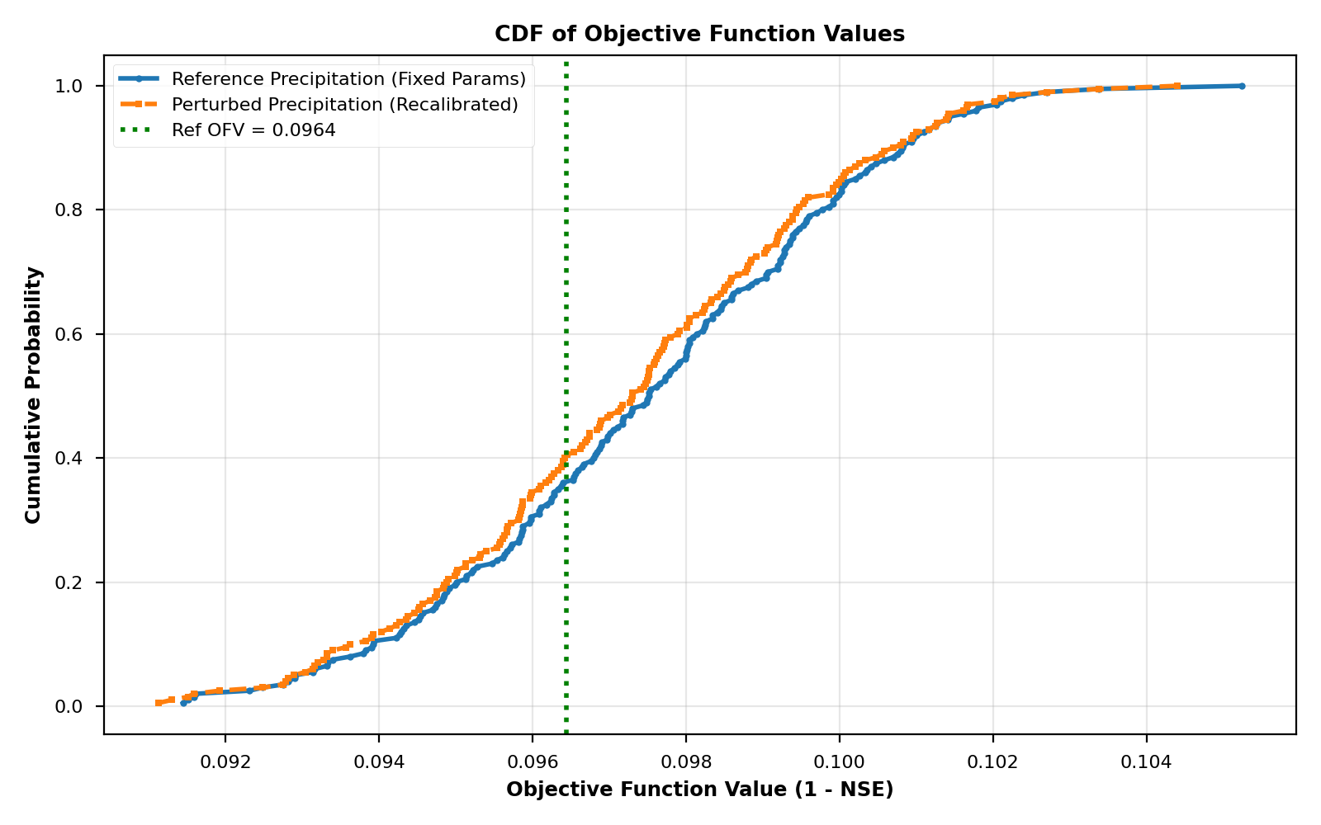
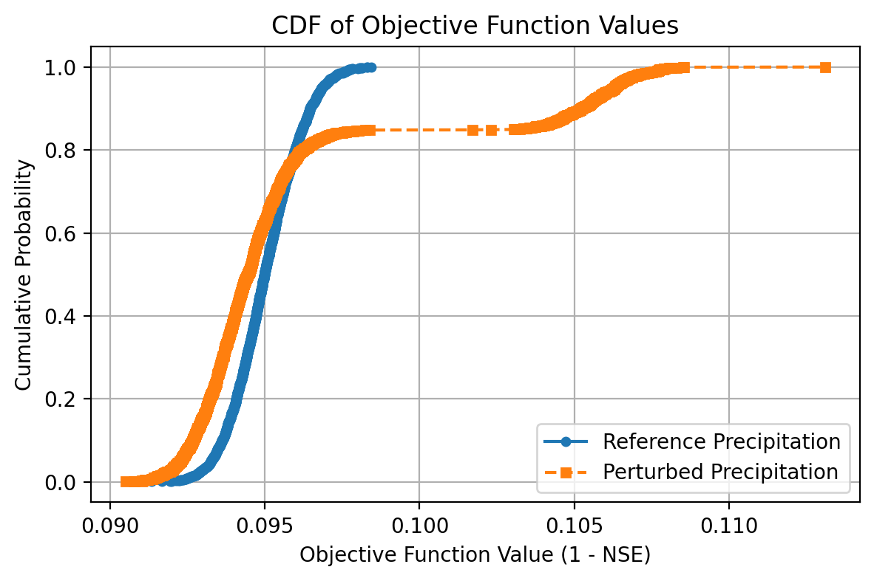
Performance distributions (OFV = 1 − NSE)
CDFs summarize variability across perturbations
• Left shift = lower OFV = better
• Blue curve: perturbed PPT + fixed params
• Orange curve: perturbed PPT + recalibrated params
• Green line: reference OFV (orig PPT + BEST_PARAMS)
Typical outcome: recalibration shifts the distribution slightly toward the reference line, but does not fully recover baseline performance.
6
Notes:
[Sources]
- A4 OFV CDF: user-generated (2_cdf_ofvs.png).
[/Sources]

Slide 7
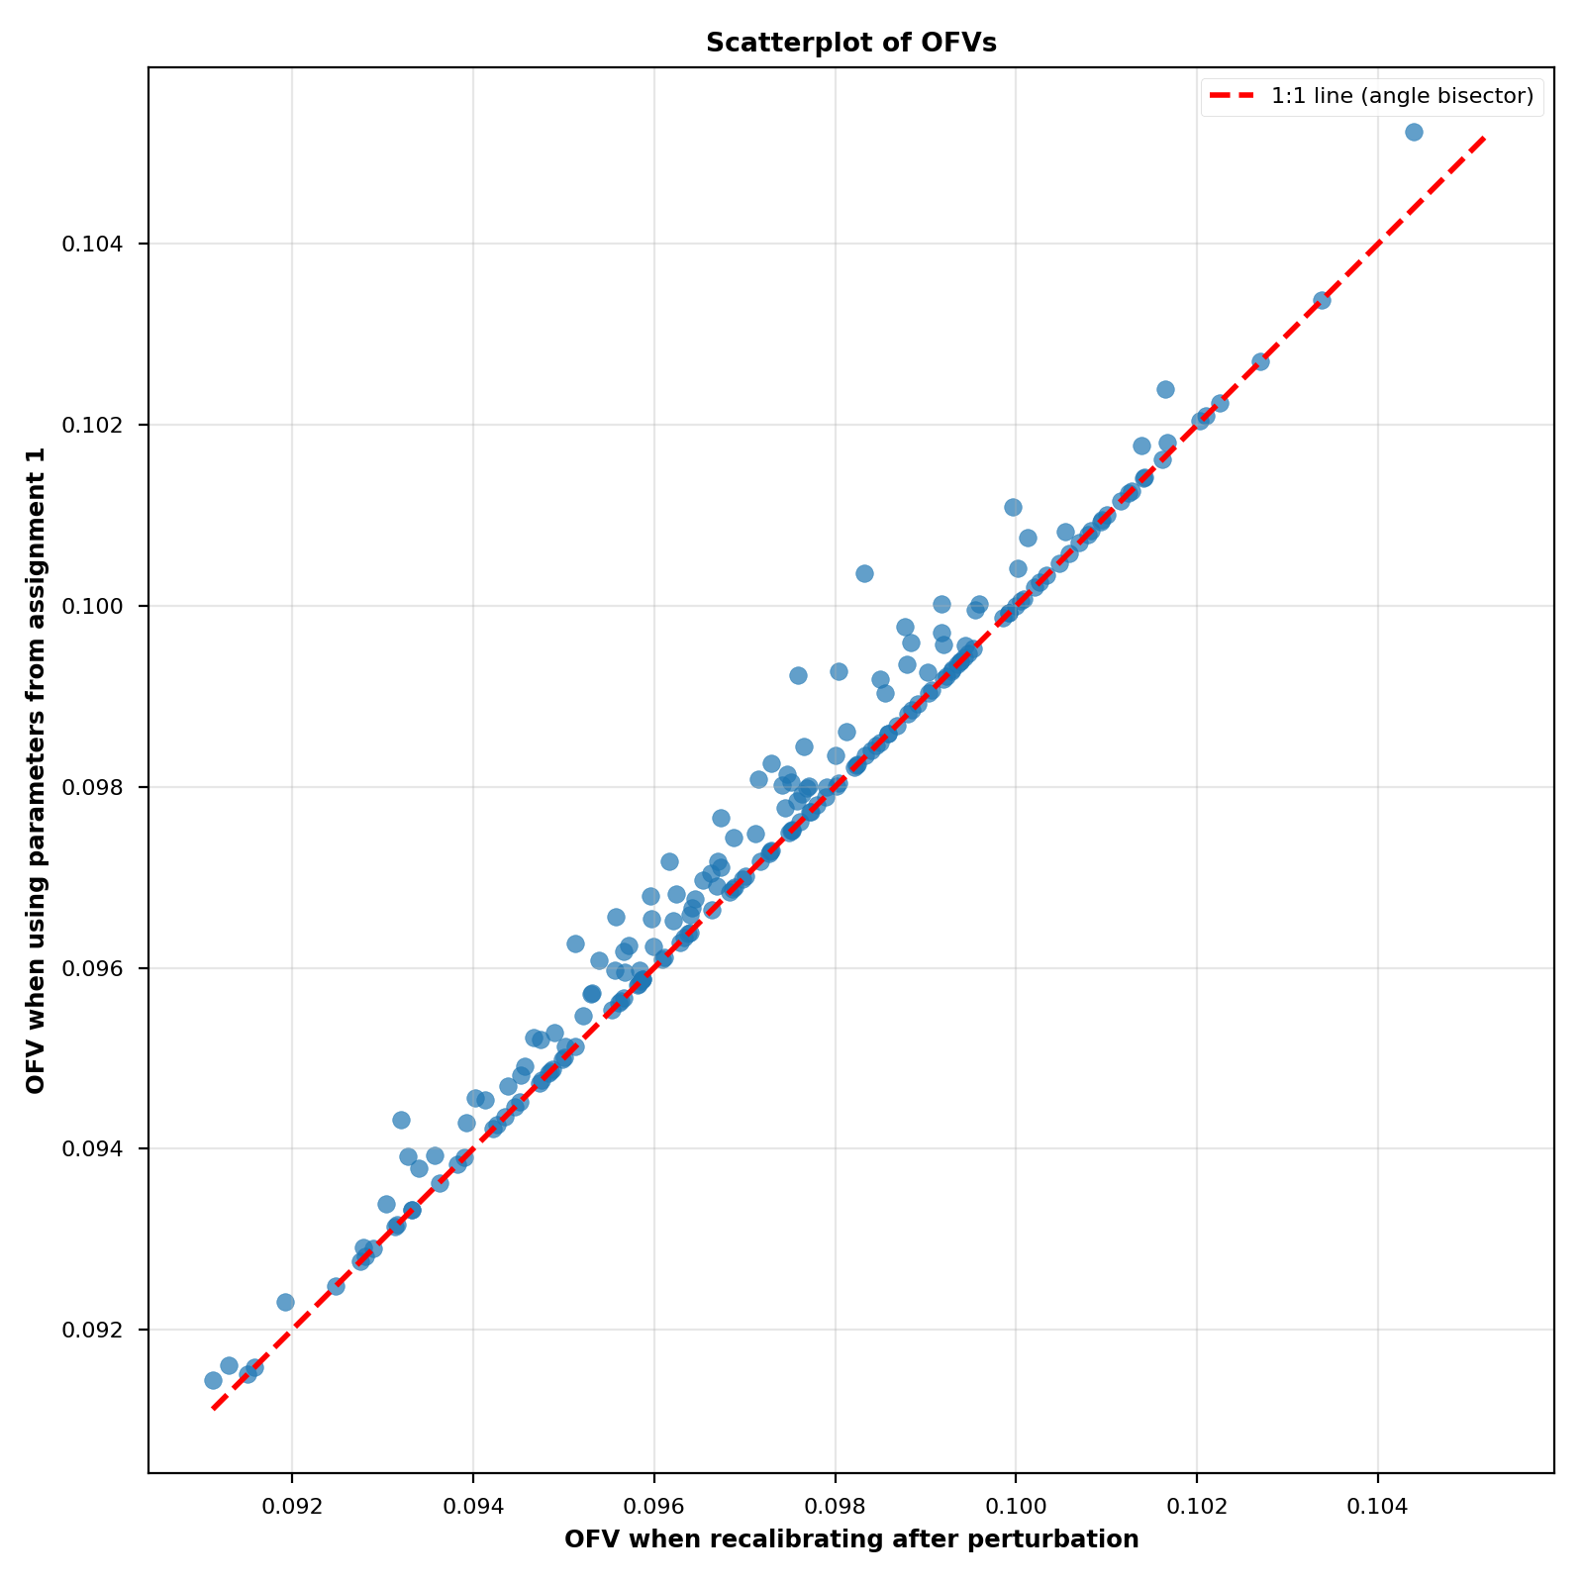
Fixed vs recalibrated performance – critical review
Using 2000 sim and DE
Using 200 sim and local optimizer
Interpretation:
• Points above 1:1 line → OFV_fixed > OFV_recal → recalibration improved
• Points below 1:1 line → recalibration worse
7
Notes:
[Sources]
- A4 OFV scatter: user-generated (4_scatter_ofvs.png).
[/Sources]

Slide 8
Recalibration method: why L-BFGS-B is acceptable
Tradeoff: speed vs global optimality
L-BFGS-B (local, bounded):
Fast → feasible to recalibrate 200–2000 times
Works well when starting from a good reference solution
Downside: can miss better global minima
Differential Evolution (global):
More robust to local minima
Much slower per recalibration
Practical compromise:
Use L-BFGS-B for many perturbations
Validate with occasional DE or multi-start checks
8
Notes:
[Sources]
- Method slide excerpt: extracted from user-provided Assignment_3_Improved.pptx (slide 15).
[/Sources]

Slide 9
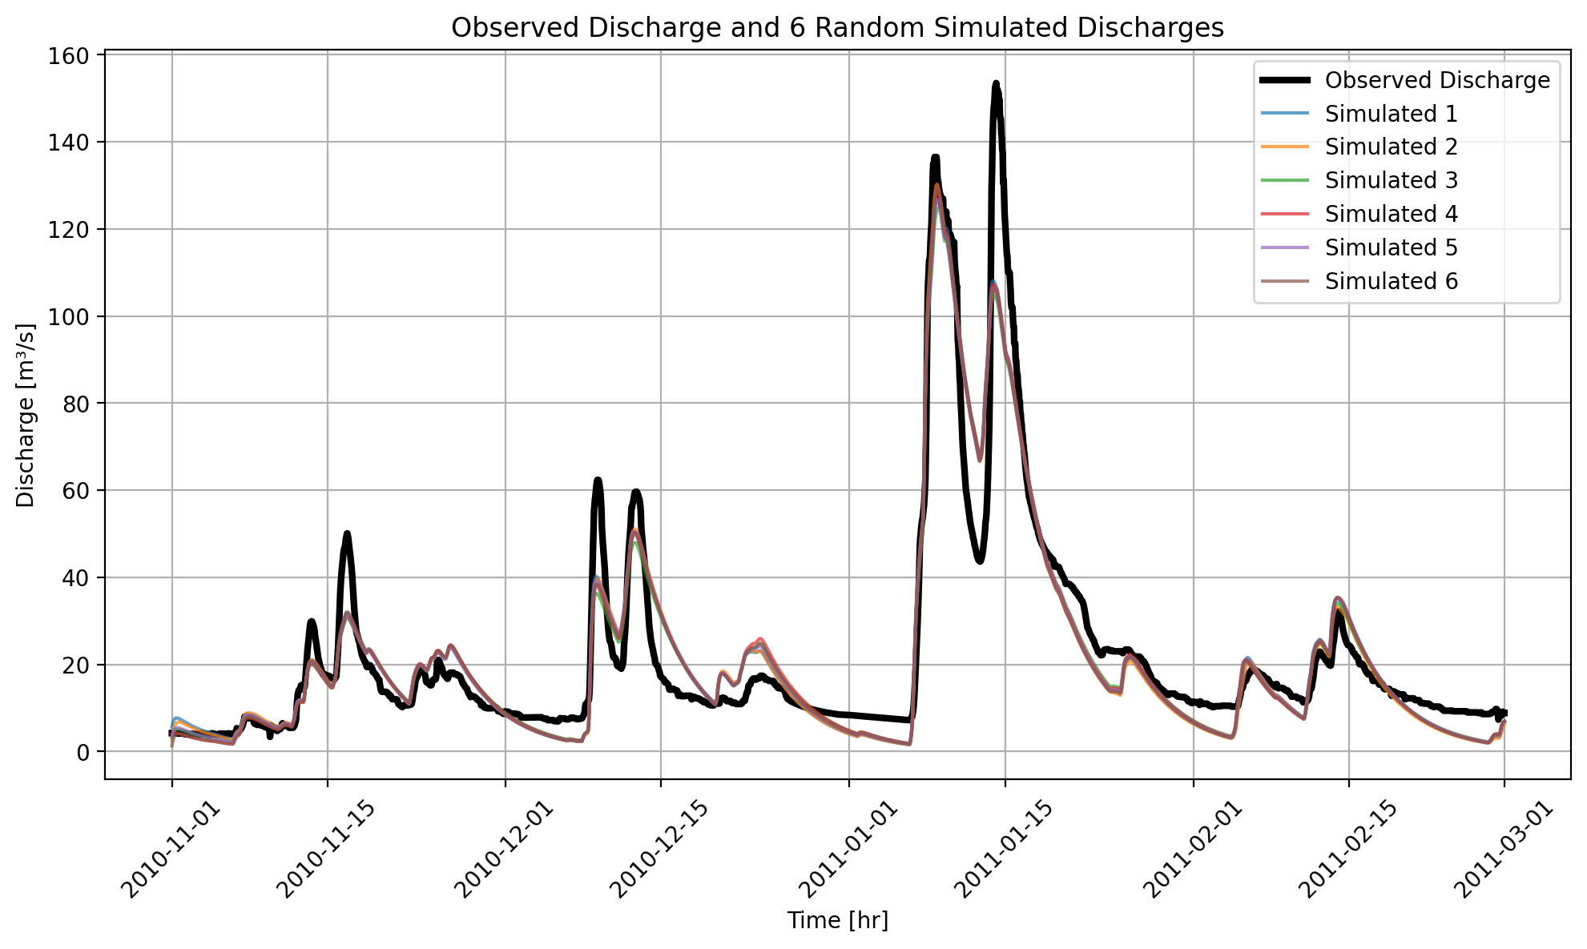
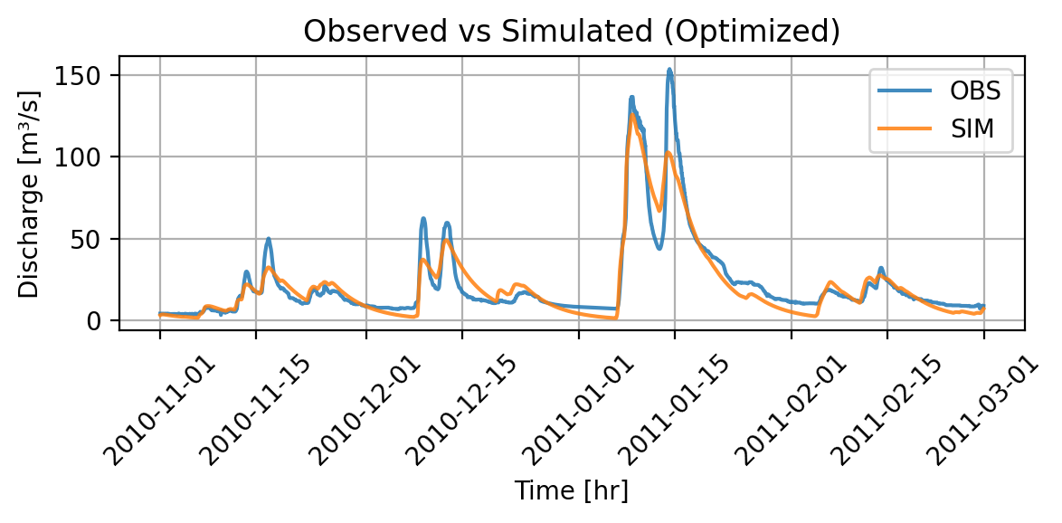
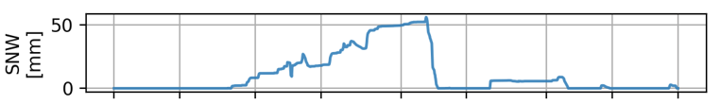
Hydrographs: baseline vs perturbed + recalibrated
9
Notes:
[Sources]
- Baseline: extracted from user-provided Assignment_3_Improved.pptx (slide 5).
- A4 hydrograph: user-generated (7_hydrograph.png).
[/Sources]

Slide 10
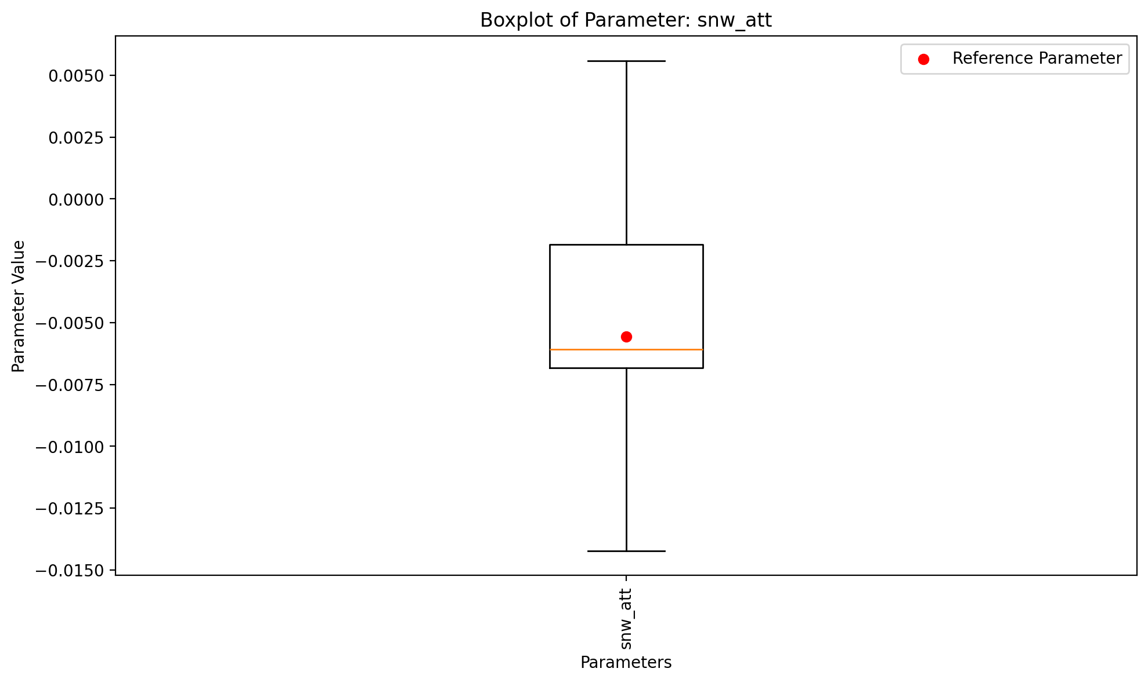
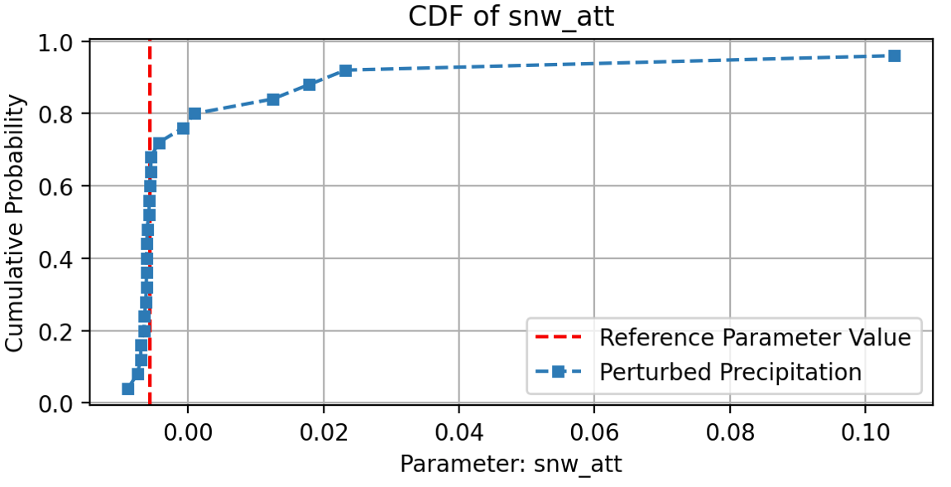
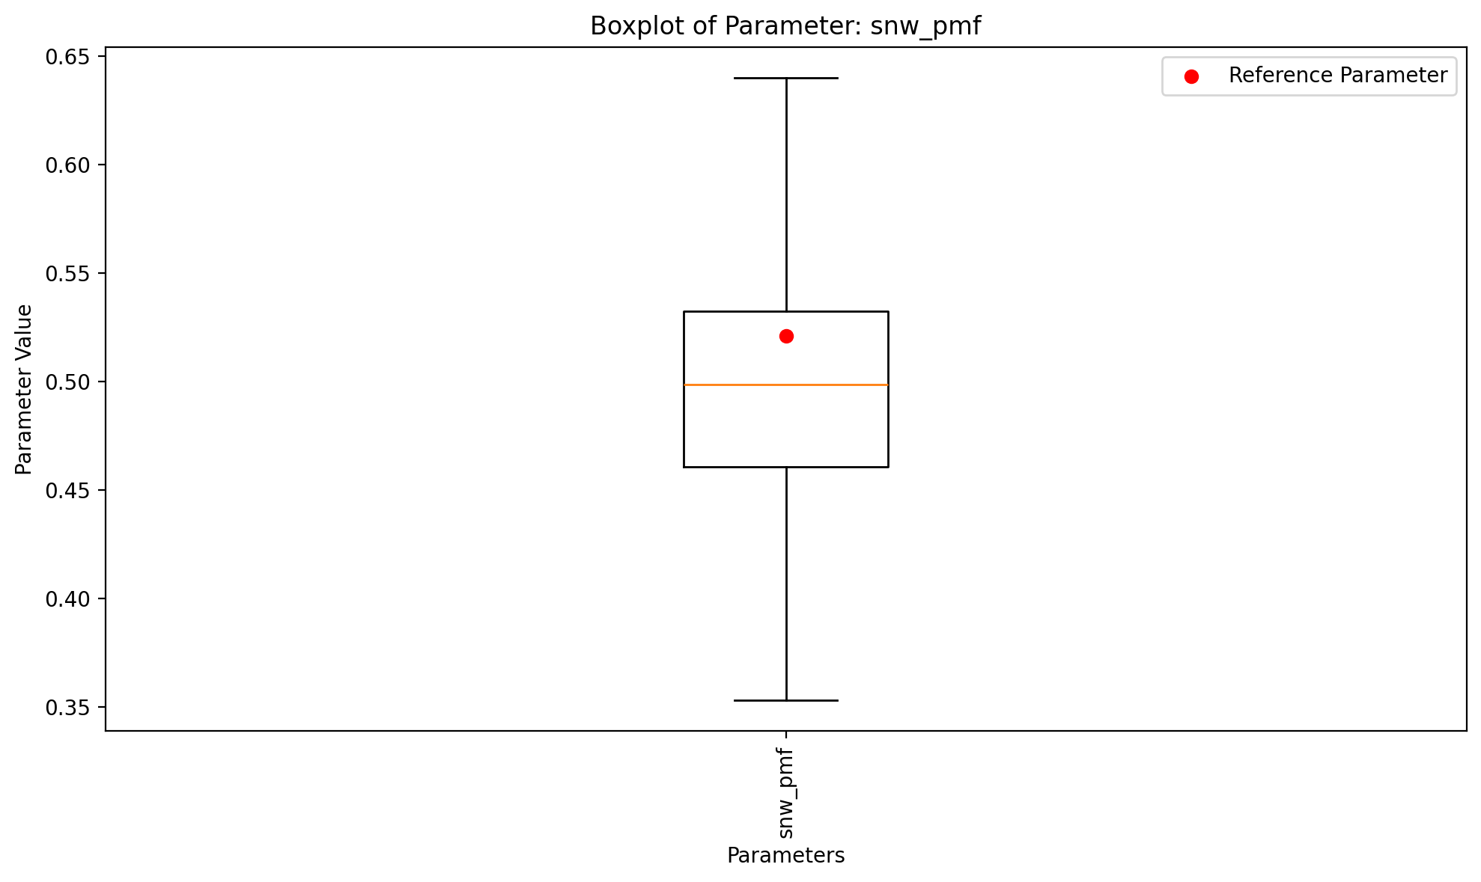
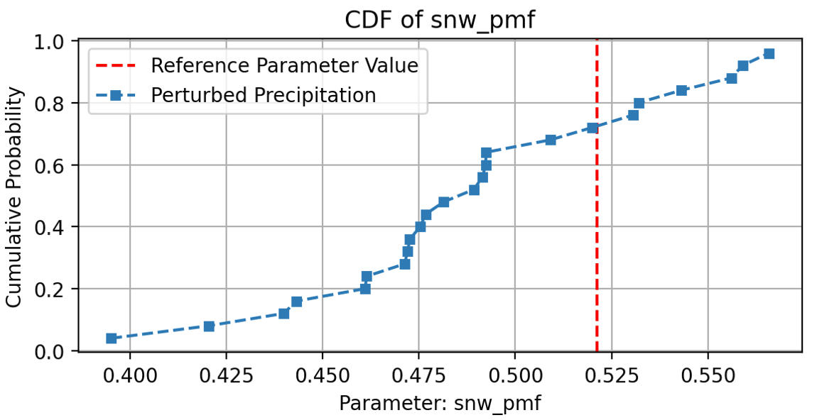
Input Uncertainty of Parameters – Snow module
Analysis of input uncertainty
HBV goes for the same thresholdtemperature which makes sense as the snow melting process should beging independently of the precipitation.
Permanent Melting Factor also small changes as the factor is related to the pptn, however should not change itself drastically due to randomness as sometimes we have too much and sometimes less precipitation
10
Notes:
[Sources]
- Q1–Q3 numbers: user-provided run output in chat.
- CDF figure: user-generated (2_cdf_ofvs.png).
[/Sources]

Slide 11
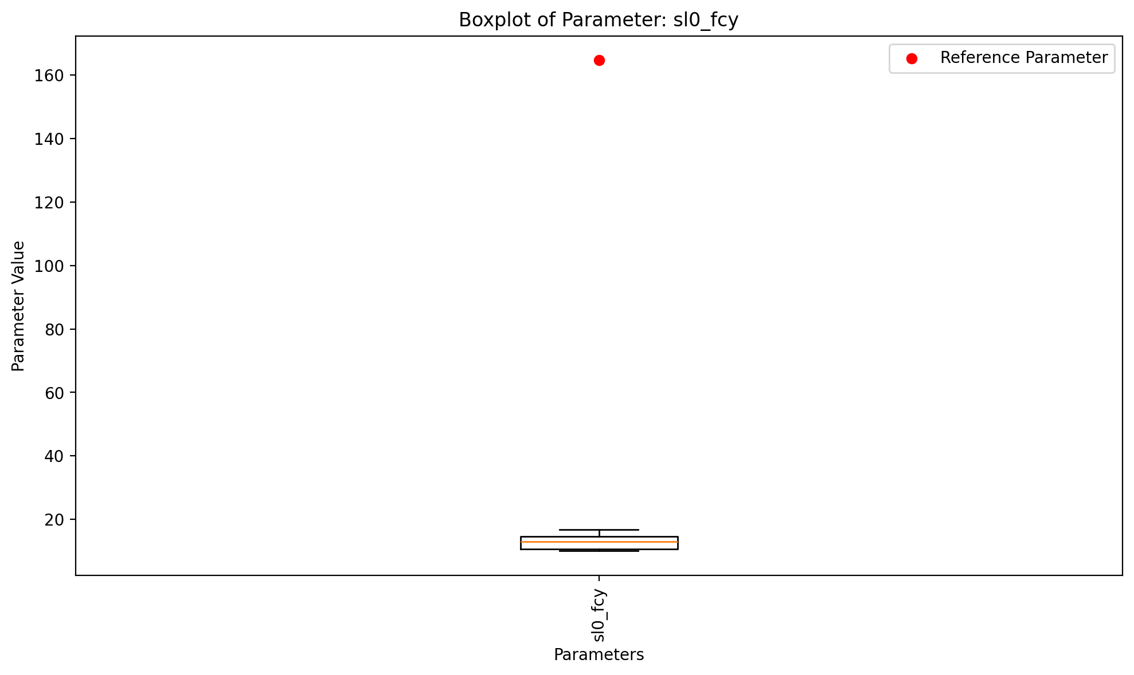
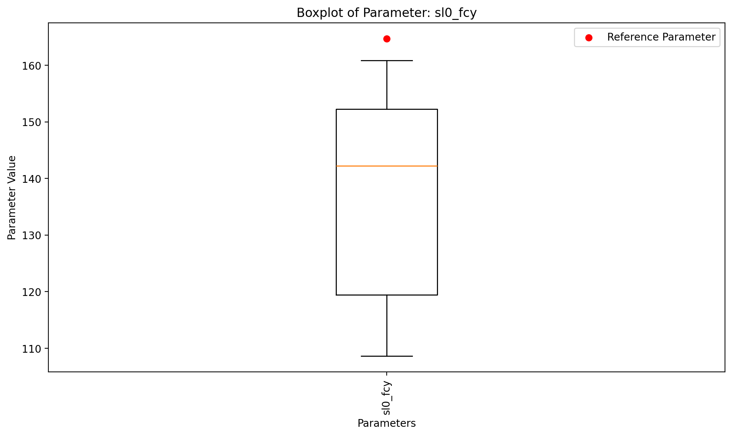
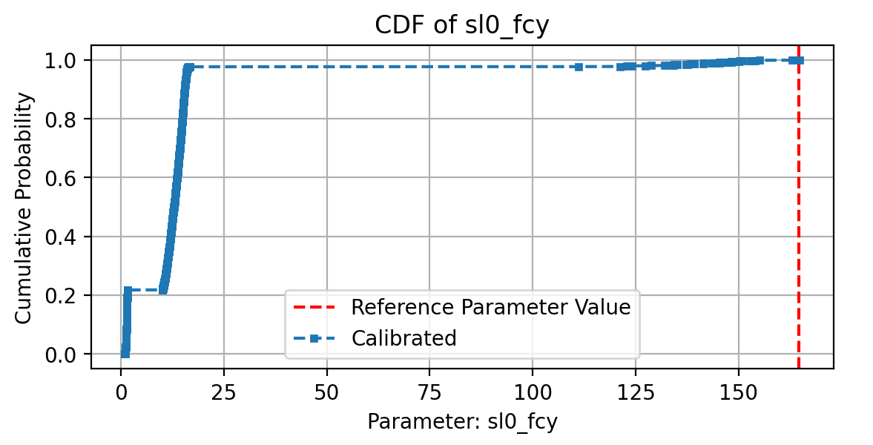
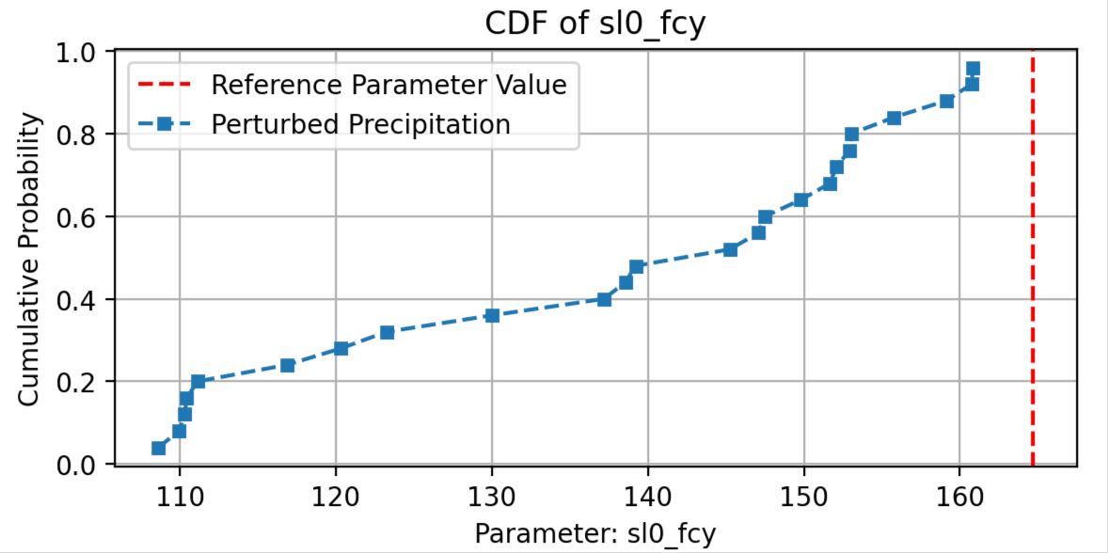
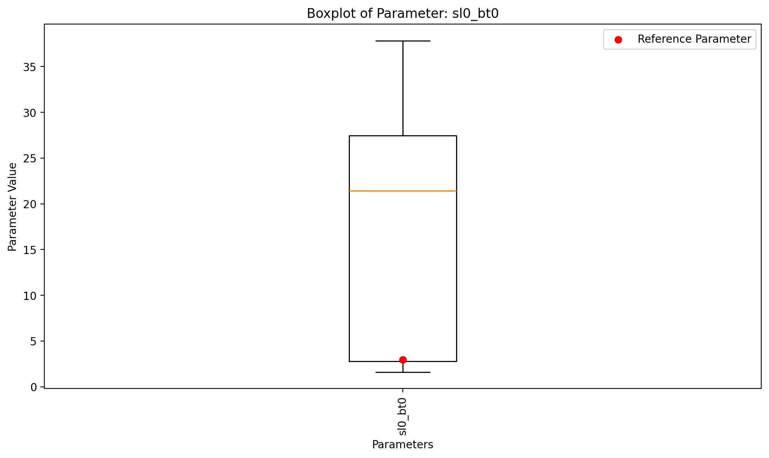
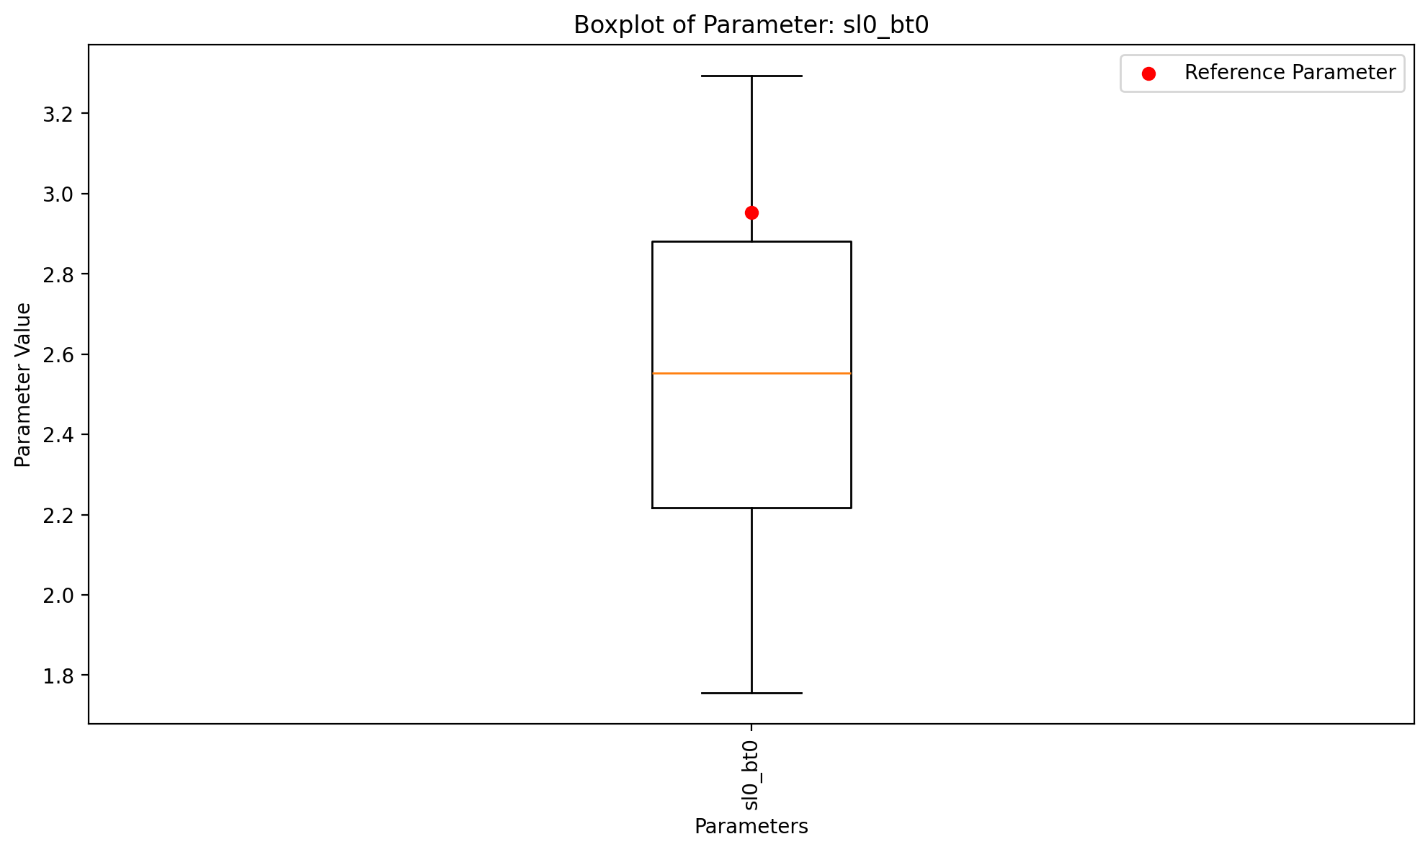
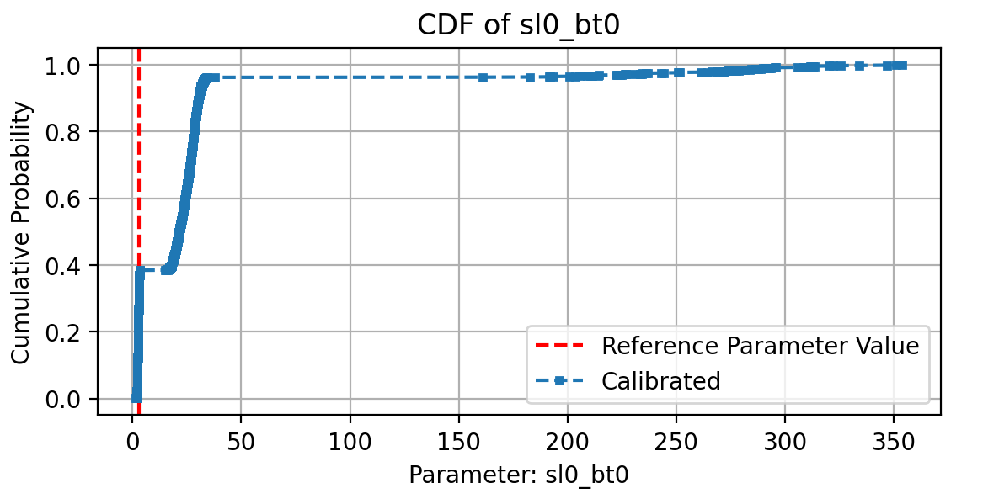
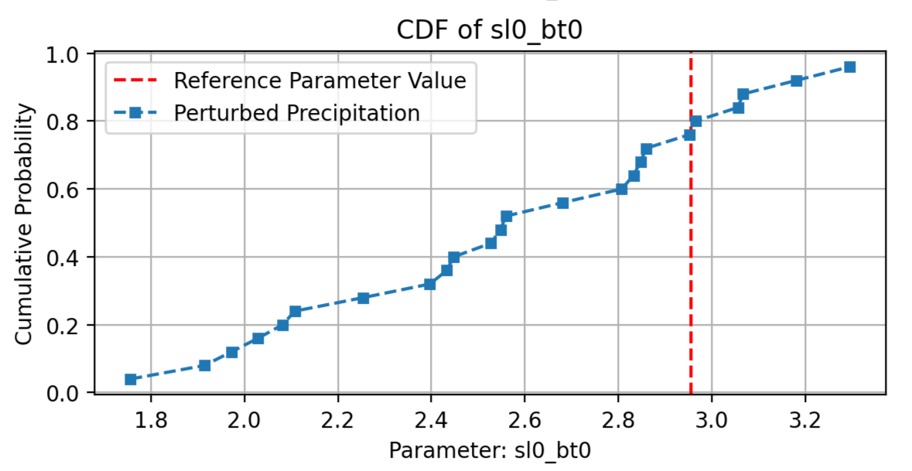
Input Uncertainty of Parameters – Soil module
Analysis of input uncertainty
The field capacity parameter seems to have more stable and less stable values. The reference value also seems to be way off.
Similarly, the same can be seen with the soil beta. Here however the reference value lies within a stable zone. This implicates sensitive parameters, which confirms the results of the previous assignments
11
Notes:
[Sources]
- Q1–Q3 numbers: user-provided run output in chat.
- CDF figure: user-generated (2_cdf_ofvs.png).
[/Sources]

Slide 12
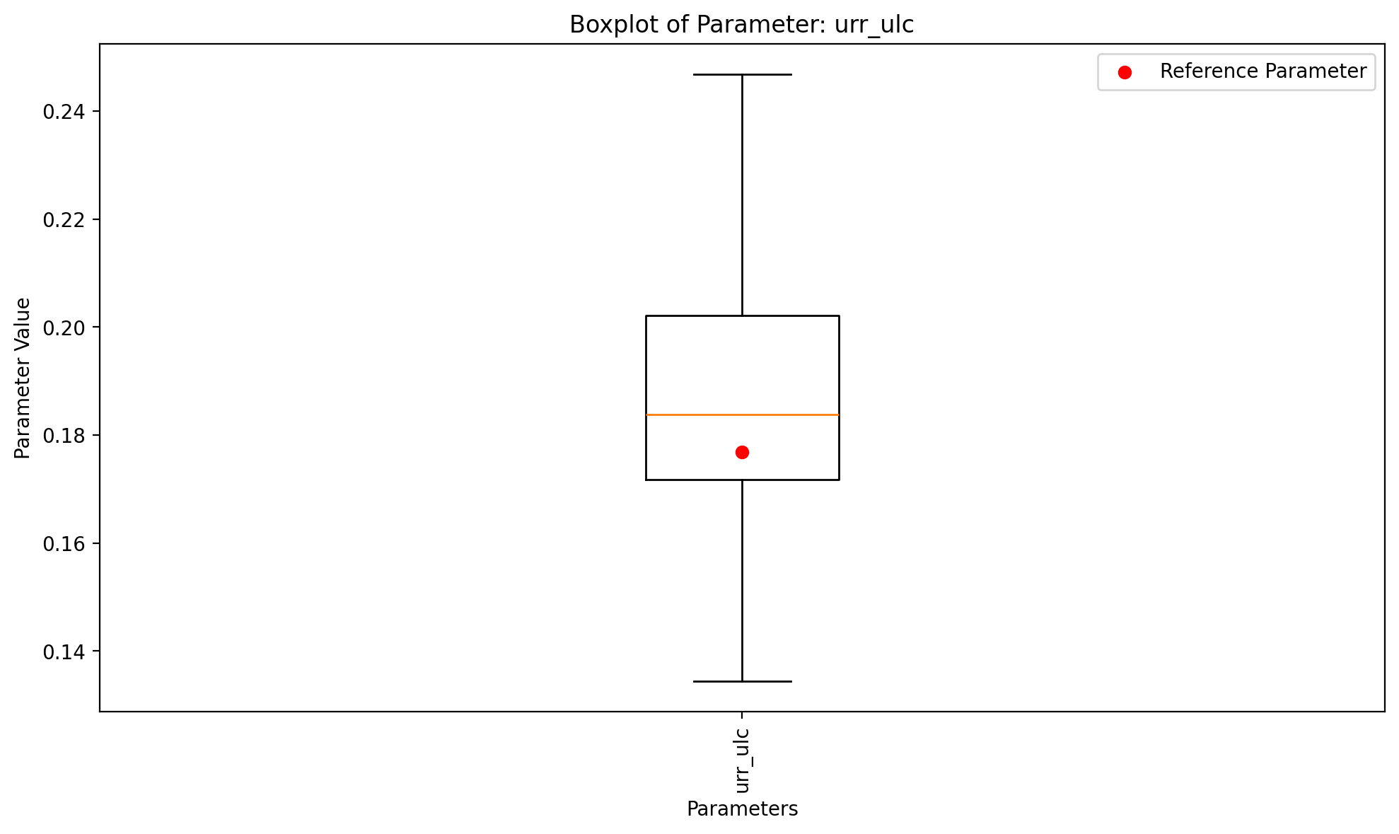
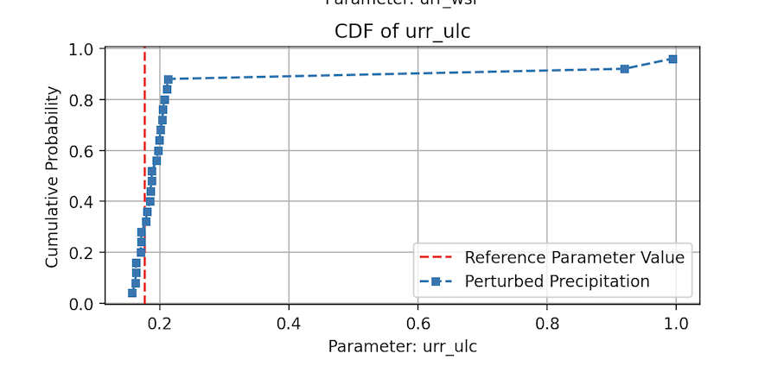
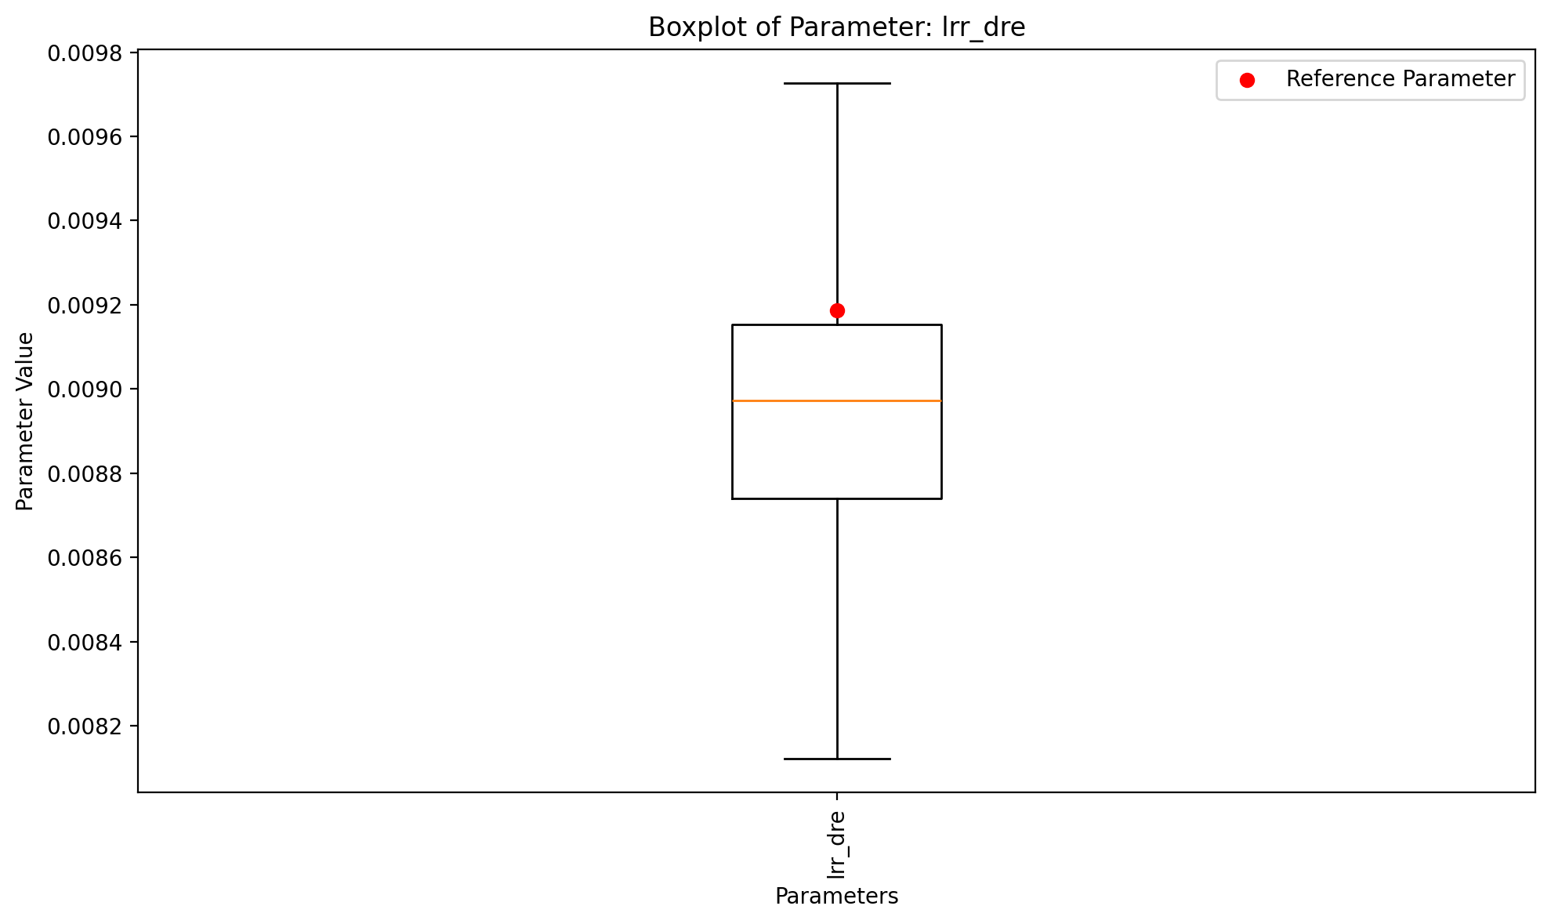
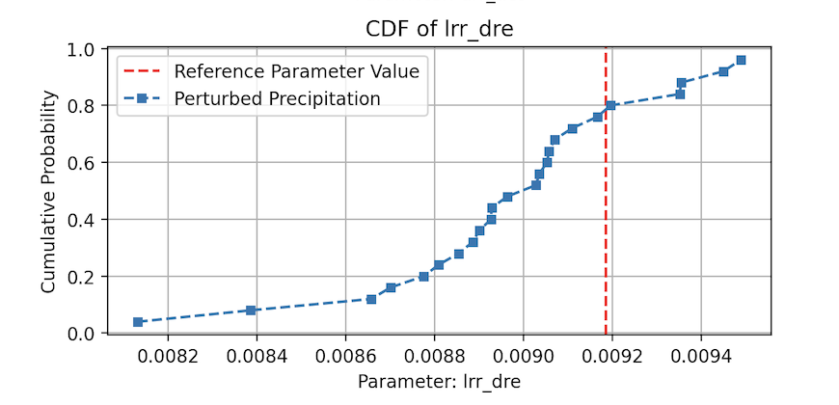
Input Uncertainty of Parameters – Run-off Response Module
Analysis of input uncertainty
urr_ulc is mostly stable but occasionally jumps to extreme values. It usually stays stable, but sometimes recalibration uses it strongly to recover fit when precipitation perturbation creates larger mismatches.
lrr_dre contributes little to compensation because it remains close to the reference and varies only slightly across runs. It is less sensitive to precipitation perturbation.
12
Notes:
[Sources]
- Q1–Q3 numbers: user-provided run output in chat.
- CDF figure: user-generated (2_cdf_ofvs.png).
[/Sources]

Slide 13
Assignment 4 answers (Q1–Q4)
Numbers below match your run output
Q1 — How often better by chance?
Q2 — Compensation amount
Mean degradation (fixed): 0.0010
Mean degradation (recal): 0.0008
Compensation: 21.9%
Fixed better than ref: 470/2000 (33.5%)
Recalibration improved compared to ref: 1530 / 2000 (76.5 %)
Q4 – Difference to OUDIN
Q3 — Use input uncertainty in calibration?
Yes. Recalibration recovered only ~22% of the average loss.
This suggests parameters cannot fully compensate for forcing errors, so the uncertainty should be accounted for during calibration and evaluation.
The models are different. Both models in the paper use fewer parameters and disregard snow. GR4J can also take water from an underground basin, in addition to rainfall. PE and rainfall were perturbed. Usage of both random and systematic error.
13
Notes:
[Sources]
- Q1–Q3 numbers: user-provided run output in chat.
- CDF figure: user-generated (2_cdf_ofvs.png).
[/Sources]

Slide 14
Thank you!

